Slide 1
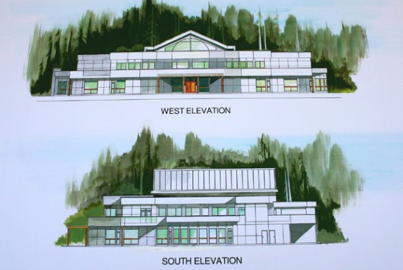
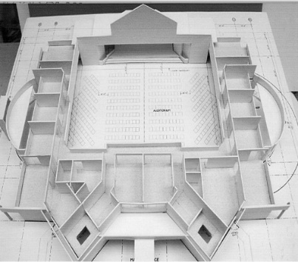
CENTRAL EFC
LPD CHURCH OF THE WEEK
Please pray for Central EFC in Courtenay, on Vancouver Island, our LPD Church of the Week.
Prayer requests are for:
Successful camping trip July 8 & 9
Upcoming baptisms
Funds for church building
Praise for new members
Praise for newcomers getting involved
in the worship team

