Slide 1
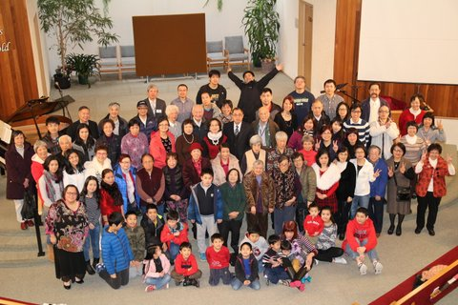
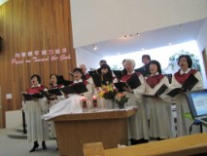
Coquitlam Chinese EFC
Praise Items:
Thank the Lord for giving us the opportunity to distribute over 600 New Testaments within the last 6 months through our outreach programs
Praise for the opportunity to witness to the community
Praise for the interest shown by newcomers in Christianity
LPD Church of the Week
Prayer Requests:
For outreach programs in the summer
Growth of the English/multicultural ministry
For the Lord’s direction and guidance for the English ministry
For young adult ministry and discipleship program

