Slide 1
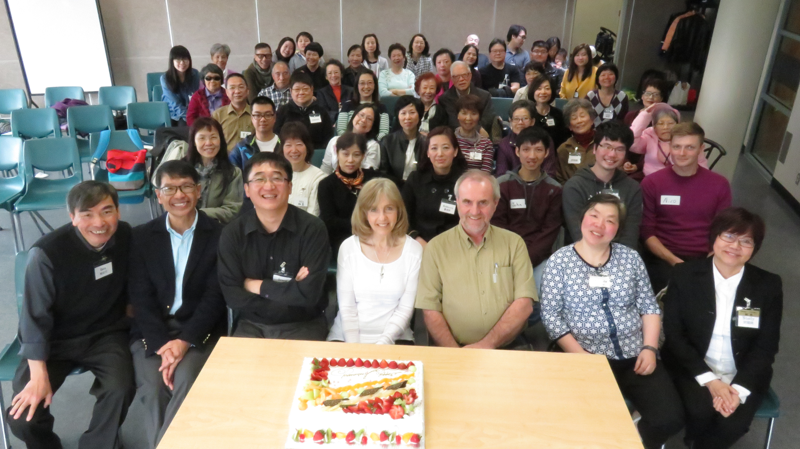
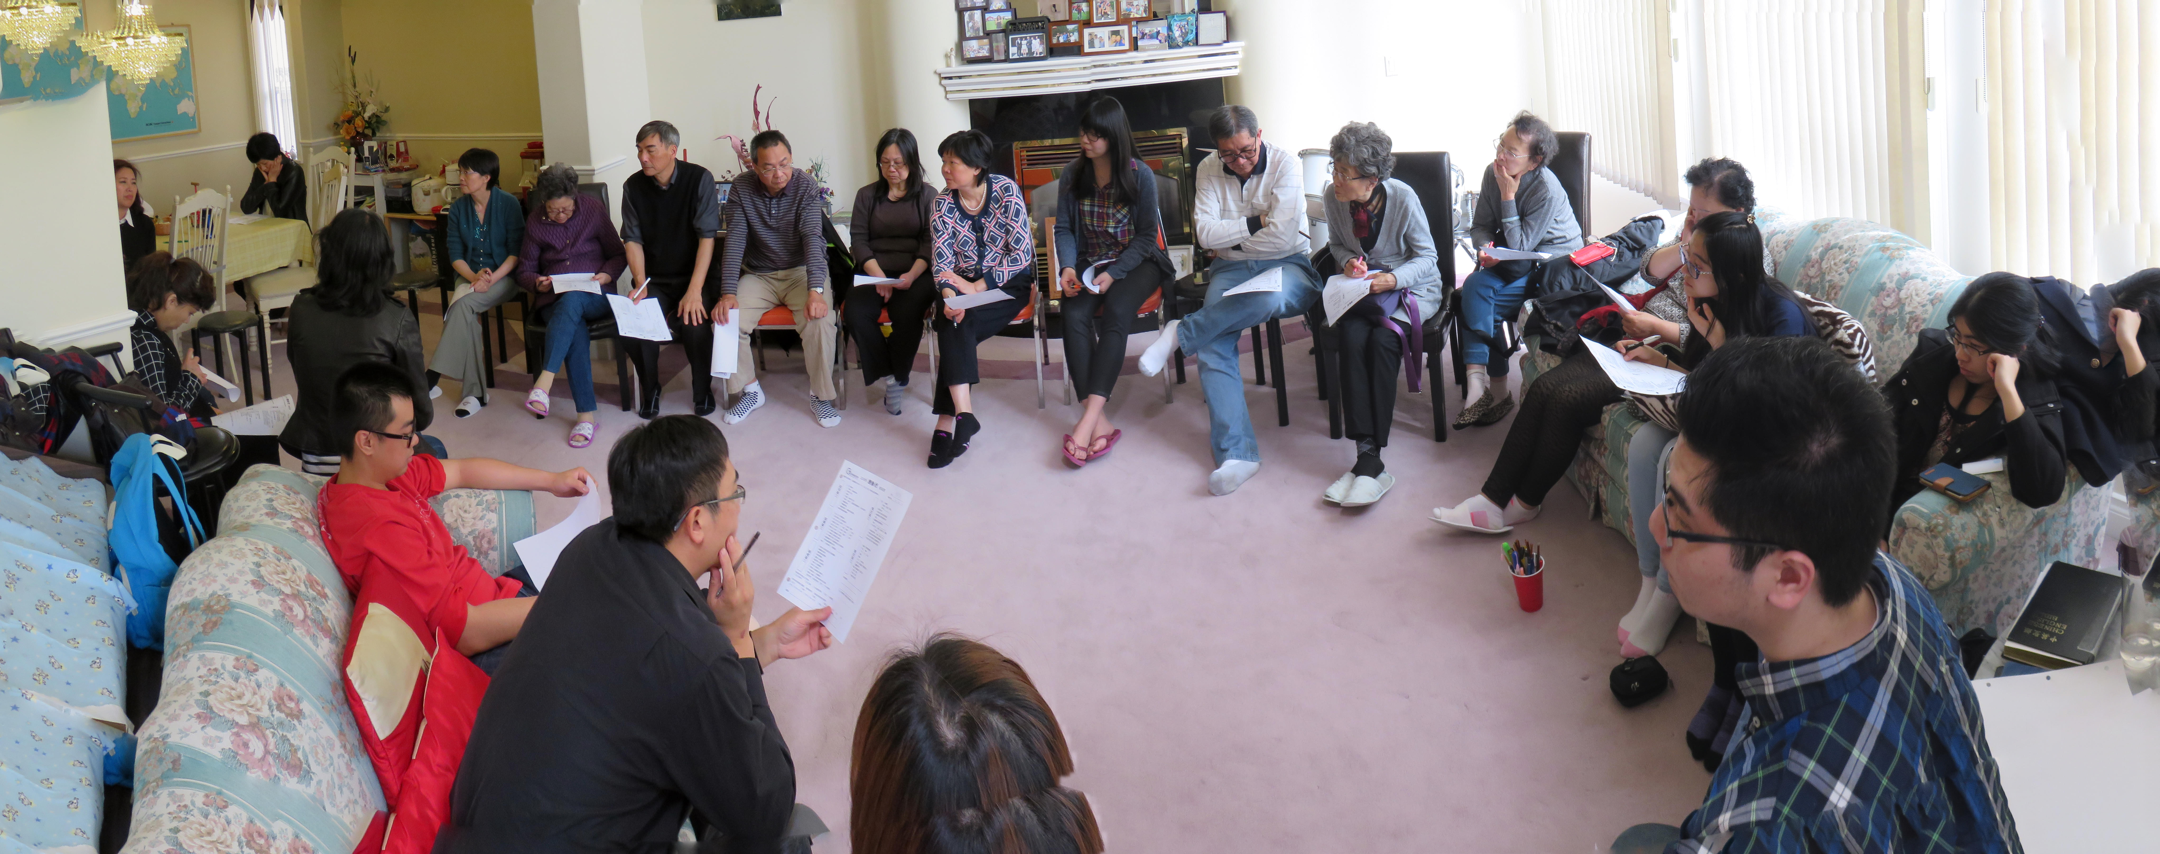
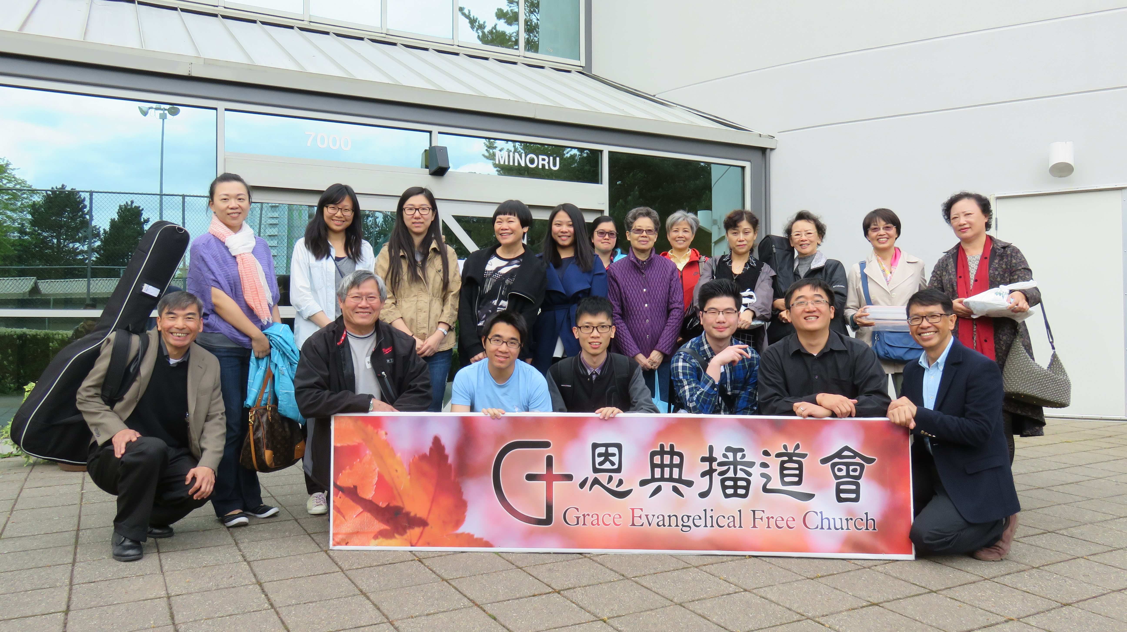
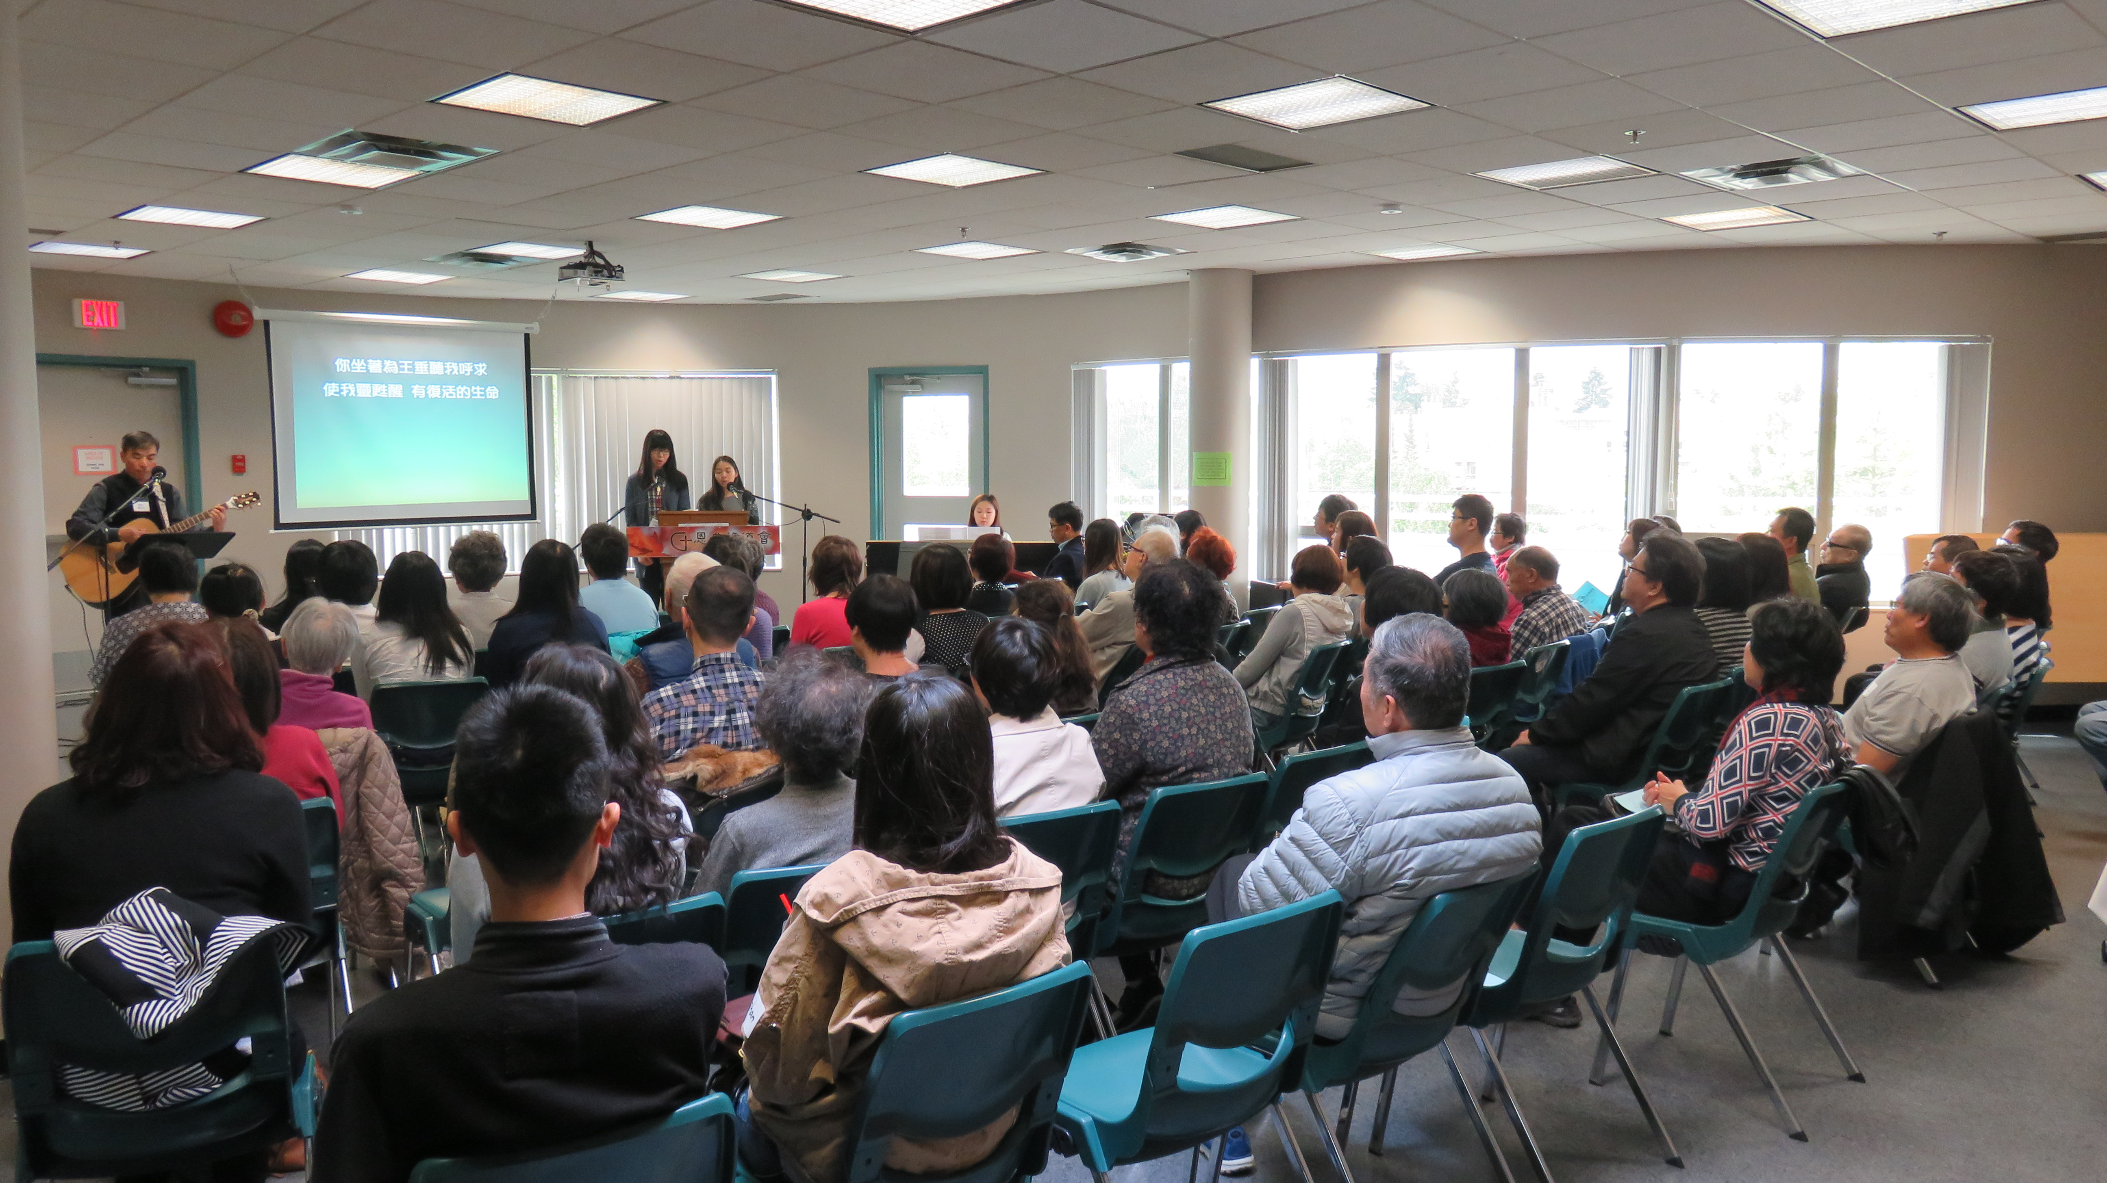
Grace efc
4th Anniversary Celebration
Members Meeting
Kamloops CEFC visit
Prayer requests: Pray for the wisdom, oneness and discernment of leaders.
Pray for the development of the Children’s Ministry.
Pray for the growth and maturity of GEFC.
lpd church of the week
Praise points: Praise that God’s grace has been sufficient for the past four years.
Praise for the Kamloops Chinese EFC brothers and sisters coming to Richmond to worship with us.
Praise for new visitors and new believers coming to GEFC each week.
Praise for the joy, unity and participation of the members.
TWU Student Leads Service

