Slide 1
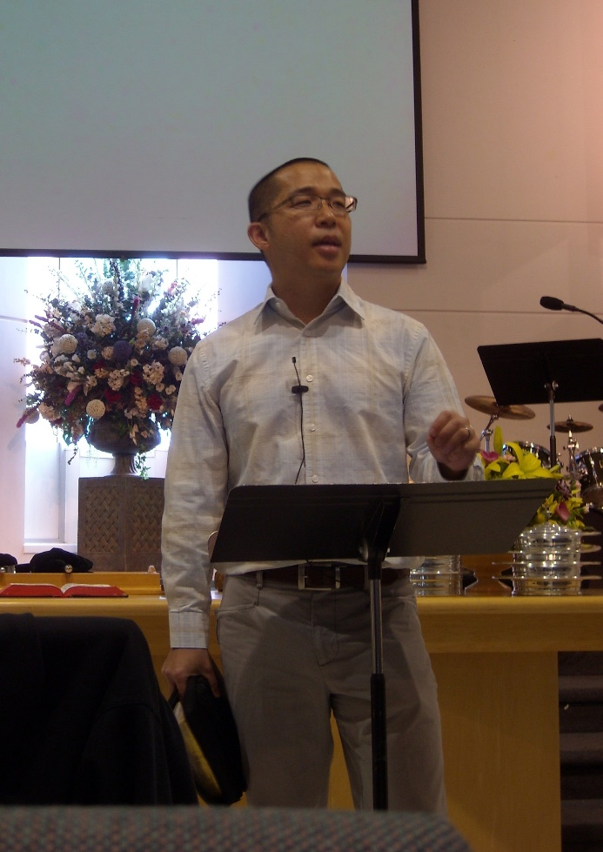
Richmond Chinese efc
LPD Church of the Week
Please pray for:
Pray for team unity and vision for the new deacon board at retreat this Saturday
English Ministry strategic planning
Chinese Ministry – Evangelistic Sunday (Feb 21st) - The sermon and focus will be on how we can be more missional and how we can take the gospel out to others
Joshua Fellowship Spring Retreat in March
Pastor Yeung is the lead pastor of the church and the Chinese congregation.
English Ministries:
Pastor, Allen Chang

