Slide 1
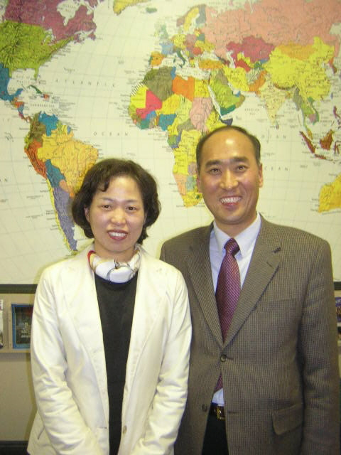
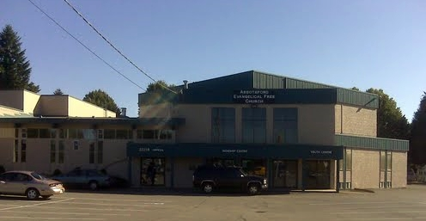
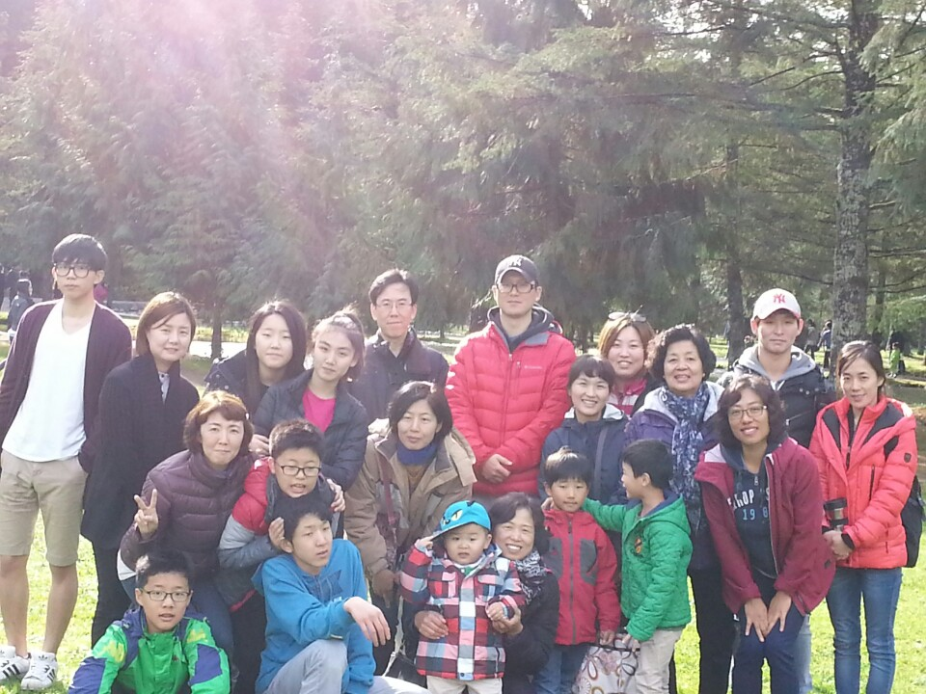
Abbotsford Vision
LPD Church of the Week
Please pray:
For growth in both maturity and numbers
That as they serve in the neighborhood and community, people would respond to the gospel of Jesus
Gratefulness for Abby EFC who continue to show love and kindness in their provision
Please pray for Pastor James and Gloria Koo and Pastor Ho IL and Kyung Ae (Park) Lee, as they serve, and reach out to newly-arrived Koreans.
This church was planted in partnership with and on the site of Abbotsford EFC in 2007, and ministers to Korean-speaking immigrants in the Abbotsford region.

