Slide 1
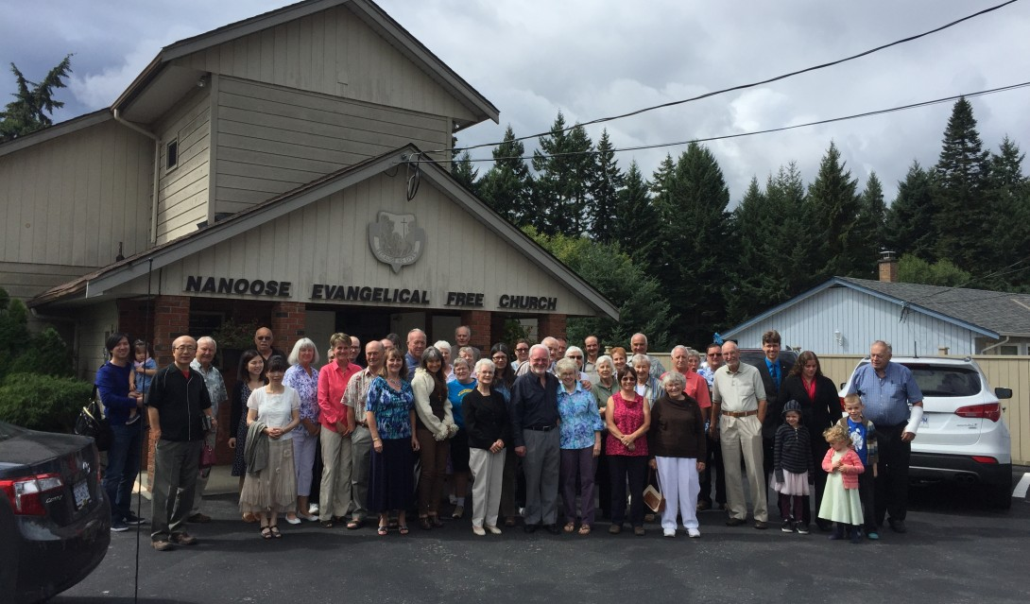
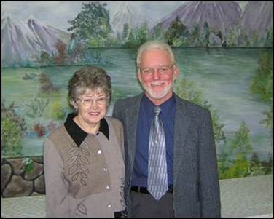
Nanoose EFC
Please pray for:
Pastor Chris and Verna Wilson, pastor interns Matthieu and Mary Howard
Our upcoming presentation at the local community center on Oct 30th - Celtic Revival with the Sky Family is a Gospel concert with fast paced Irish step dancing, fiddles, guitar and song and a strong Gospel message.
Wisdom for our leadership team of elders and deacons
Thanks and prayer for the ongoing work of our ladies "sewing for missions ministry"
LPD Church of the Week

