Slide 1
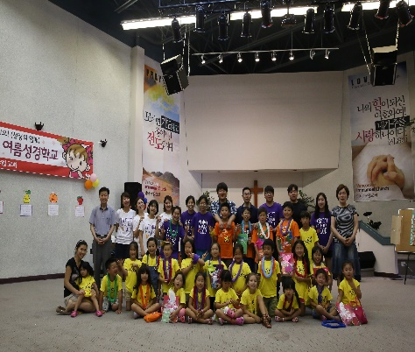
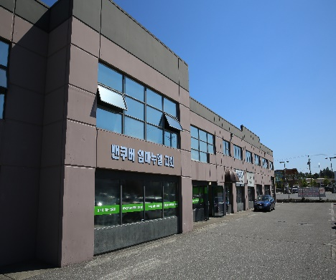
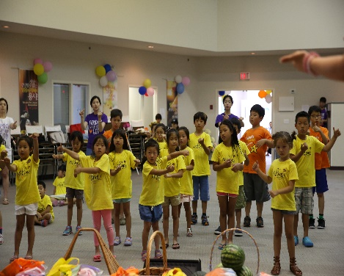
Immanuel Korean Church LPD’s Church of the Week
Prayer requests:
There was a summer VBS camp from June 31st to June 2nd. Please pray for spiritual growth of our kids.
Please pray for our senior pastor, David Song's health.
Please pray for the summer retreat of our youth and young adults from Aug 24 to Aug 27 at Manning Park.
Section
Insert text or image to convey key point.

