Slide 1
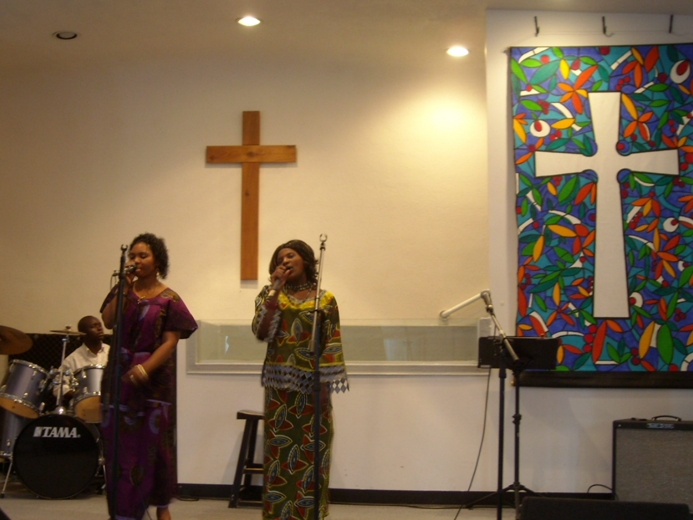
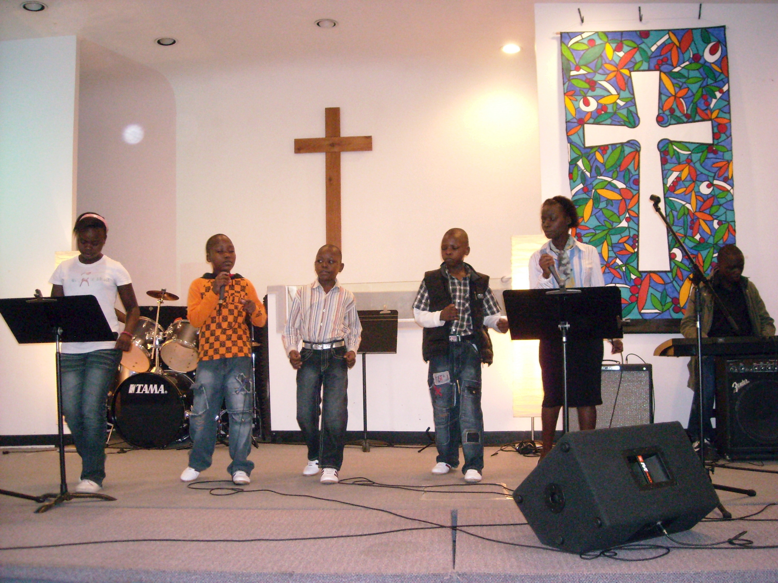
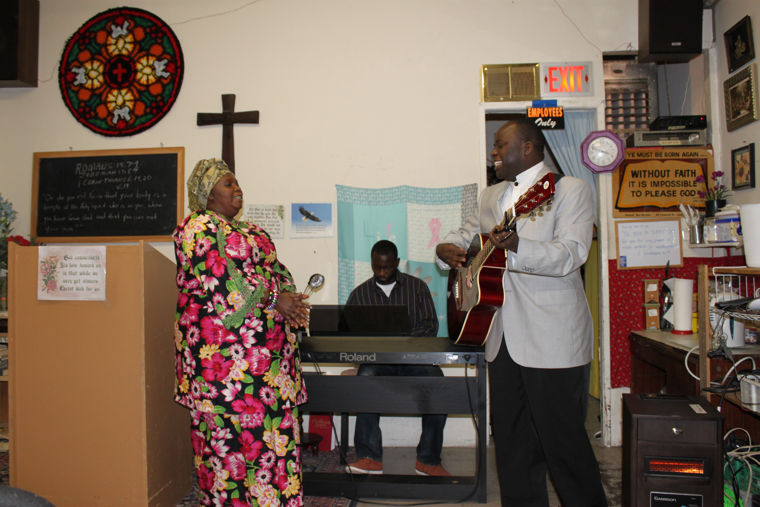
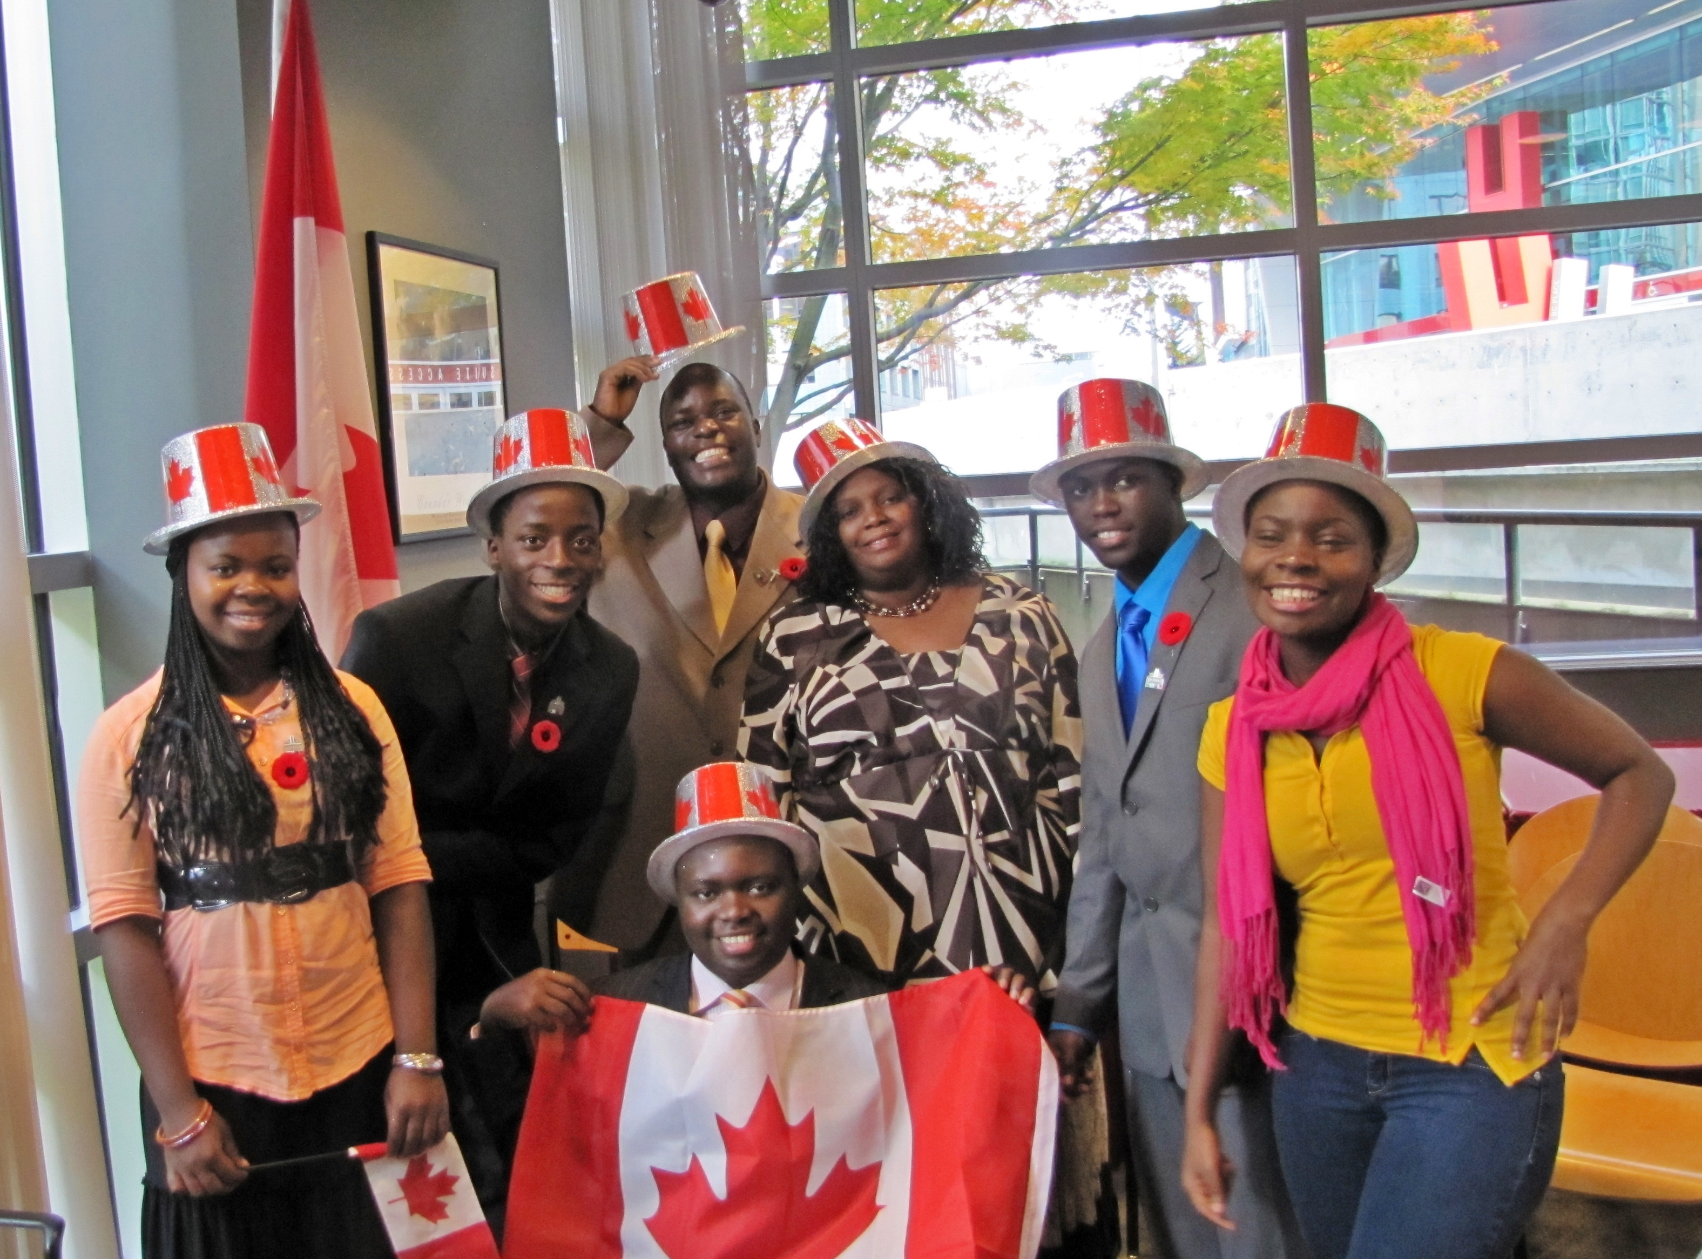
LPD’s Church of the Week
Jesus Grace International Church
Please pray for:
Employment for these recent immigrants and refugees from Africa.
A new venue to hold Sunday services.
God to work through the church to reach the local African community

